Slide 1


Slide 2


What is the purpose of a CV?
To inform the employer about your education, work experience, skills and interests
To ‘sell’ these qualities and to persuade the employer to invite you to interview

Slide 3

When an employer asks for an application in that format
When an employer states ‘apply to…’ without specifying the format
When making speculative applications
Notes:
What is a speculative application?
Writing to an employer who has not actually advertised a vacancy but who you hope may have one

Slide 4

It is not ‘one size fits all’, you need to tailor your CV to each position you apply for.
Research the company. Do they have a mission statement or core values? What will they be looking for in you? Who works there at the moment? What are they passionate about?
Notes:
If you know someone at the company, ask them for advice.
You have a chance to show evidence of how your values match those of the company.

Slide 5

There are four main things employers will look at in CVs:
Education - ability to think clearly, analyse and assess information, draw conclusions, work independently, research
Work experience - ability to get on with people, work under pressure, meet deadlines
Leisure interests - ability to plan and organise, co-operate with others, compete, lead, work hard to achieve results
Specific skills – e.g. driving licence, computer skills, foreign languages, artistic skills

Slide 6

Chronological
In date order (starting with the most recent first) e.g.
EMPLOYMENT
April – December 2011: Venture – Editing Assistant
Working with Photoshop, I have learnt various editing styles. I have gained customer service experience and understand the importance of listening to what customers want in order to achieve high sales.
February 2009 – March 2010: Topshop – Retail Assistant
My interest in fashion enabled me to help customers and to suggest styles that might suit them. I helped to design the layout of the stock in the store, with an aim to increase our revenue by positioning various items in ‘eye-catching’ places.

Slide 7
Skills based
Focusing on skills e.g.
SKILLS
Attention to detail – as an Editing Assistant at Venture, I needed to prove that I could spot any mistakes or flaws in the photographs, as well as being attentive to the requests of the customers
Computer skills – I regularly used Photoshop during my time at Venture. I am also a competent user of Microsoft Office, which I proved throughout my time as a Retail Assistant at Topshop, where I was often required to produce reports on our sales
Customer service – in all of my roles, customer service has been of key importance. I have experience of dealing with difficult customers, and try to ensure that every customer is satisfied with the service they have received.

Slide 8

Name (as a heading rather than ‘CV’)
Website/online portfolio/CV
Address (term-time and home)
Telephone number
Email address
  Make sure this is a professional email address
The following are not requirements, but if you wish, you can include:
  Nationality
  Sex
  Date of birth

Slide 9

Start with the most recent
Don’t forget your current study
  Mention relevant modules
  You might like to mention top marks
You don’t have to put your grades on if you weren’t happy with them
Include the years of study
Primary school not needed

Slide 10
Education and Qualifications
2011 – Present University of Kent
BA (Hons) Fine Art
Modules include: Contextual Studies, Creative Investigations
Project: Communication and Critique
2009 – 2011 Maidstone Grammar School
A-levels: Media Studies (A), Art (B), Information Technology (C)
2005 – 2009 Wrotham School
GCSEs: 8 GCSEs including English and Maths

Slide 11

There is no need to list every job you’ve ever had – detail the most relevant
Don’t just list your duties – sell your skills. Which skills are relevant to the position/company you are applying to?
Dates, name of company, position and skills:
April 2010 – Present Museum of Kent Life
As a shop assistant, I have learnt the importance of providing great customer service to gain maximum sales. I am responsible for organising stock and ensuring that costs are controlled. Carrying out weekly risk assessments has increased my awareness of health and safety issues.

Slide 12
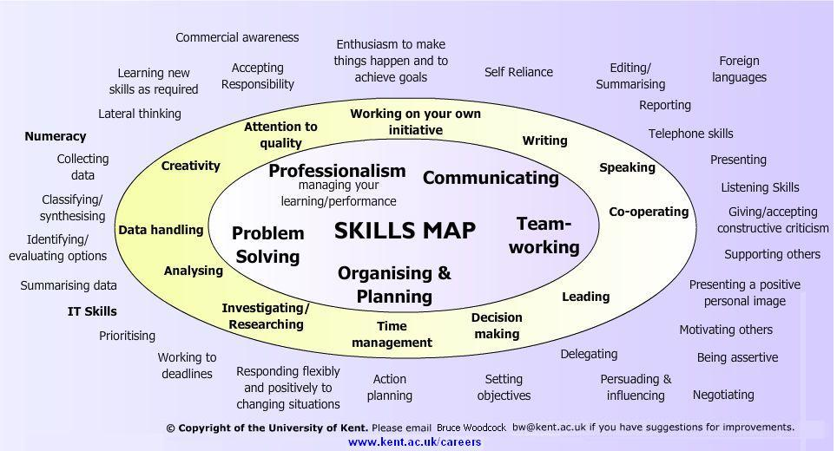
What examples can you give from your work experience?
If you have no paid work experience, give examples from voluntary work or from your course

Slide 13

created instructed analyzed produced
negotiated designed calculated maintained
administered controlled reviewed
consolidated delivered founded increased
studied invented supplied detected
programmed recommended distributed
developed solved prepared installed
selected arranged formulated solved started

Slide 14
Choose interests and activities which can demonstrate skills relevant to the job such as:
      Teamwork
      Organising
      Commitment
      Your intellectual abilities
      Your personality
      Your artistic ability
Talk about your passion for music/art etc.

Slide 15

The first visual impression of your CV is important
For standard CVs, use plain white A4 paper
Do not double side
Keep your CV to two sides of paper
Check your spelling
Use bullet points and bold font but in moderation

Slide 16
Formatting – make sure it’s consistent
Size 10-12 font (depending on font style)
Clear font e.g. Arial, Calibri
Focus on accomplishments
Target your CV to that job/company
2:1, not Two One or 2,1
Use short, concise sentences
Consider your audience

Slide 17

Be creative in design BUT ensure all relevant CV information is included
See http://www.careers-creative-living.co.uk/cv_gallery
See http://www.mikeclegg.co.uk/
See the creative CV guide for ideas & suggestions
Include a weblink to your portfolio

Slide 18

Ideally, one academic and your manager
Ask permission from your reference and let them know what position(s) you’ve applied for
Use relevant references if possible
You can say ‘references available on request’ rather than including contact details if you wish

Slide 19

Never send a ‘naked’ CV
There are two types of covering letters:
    Speculative/accompanying letter
    Letter of application

Slide 20

Should be three short paragraphs
Opening paragraph – why you are writing
Paragraph 2 – show knowledge of employer, highlight your skills
Paragraph 3 – Refer to your CV and availability

Slide 21

Used when asked to ‘apply in writing’ or ‘send CV and cover letter’
1 side of A4 – similar to a UCAS personal statement
Opening paragraph – motivation for the job
Followed by background skills and experience developed through study, work experience and paid work
‘Matching up’ with job description
What you can offer the employer

